Slide 1
AI Water Quality Forecasting System
CSE276: Artificial Intelligence Foundations | CA1 Project P18 | Team ZJ18
Prince Sahu
Reg. No. 12508888
Ridham Dadwal
Reg. No. 12514189
Lovely Professional University

Slide 2
Introduction
Why water quality matters
Why forecast it
What this project does
Monitoring shows today's quality. A forecast gives authorities time to treat water, warn users and plan.
Computes a Water Quality Index, forecasts it with AI models and shows alerts in a demo app.
Rivers carry pollution from cities, farms and industry, and their quality changes with season and rainfall.

Slide 3
Forecasting river water quality for early action
Problem (SIH1694)
Objectives
Authorities need to know what river water quality will be soon, not only what it is today. We build a multivariate forecasting and decision-support system on public data.
Clean multivariate water-quality data
Compute a Water Quality Index (WQI)
Forecast WQI and beat a naive baseline
Turn forecasts into alerts in a demo app

Slide 4
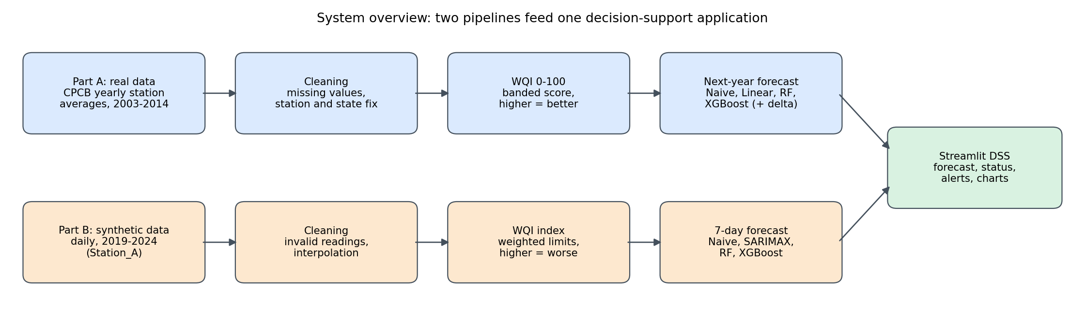
System overview
Part A (real, yearly) and Part B (synthetic, daily) share one decision-support app.

Slide 5
Part A data: real Indian river stations
1,988
439
20
2003-14
rows (station-years)
stations
states and UTs
yearly averages
Source: Kaggle "Indian water quality data" (Anbarivan.N.L), government-sourced
Parameters: temperature, DO, pH, conductivity, BOD, nitrate, fecal and total coliform
Not available: turbidity, daily or monthly readings

Slide 6
Part B data: synthetic daily series
2,192
6
3%
15
days, 2019 to 2024
parameters
missing per column
bad readings added
Why: no public daily river dataset found for this assignment
Design: annual temperature cycle, monsoon rise in turbidity and BOD, fall in conductivity and pH
Smooth by design, so scores are optimistic and used only to validate the 7-day pipeline

Slide 7
Cleaning the real data
Missing values
Station identity
Text "NAN" became missing and was never replaced by zero
About 6% of codes were "NAN"; location name used instead, rows with neither dropped
State field
Short histories
203 raw values became 20 states and UTs; location text split out, spellings unified
Average 4.5 years per station; at least a quarter have only one year

Slide 8
Water Quality Index (WQI)
Part A: 0 to 100, higher is better
Part B: higher is worse
Banded sub-scores, weights: DO 0.281, coliform 0.281, BOD 0.234, pH 0.165
Weighted arithmetic index from pH, DO, turbidity, conductivity and BOD
Excellent 90+, Good 70-90, Medium 50-70, Bad 25-50, Very Bad below 25
Excellent up to 50, Good to 100, Poor to 200, Very Poor to 300, Unsafe above
1,955 station-years: Good 1,434, Excellent 219, Medium 195, Bad 93, Very Bad 14
Mean 94.7; Good 1,508 days, Poor 684 days

Slide 9
Forecasting setup
Part A: next year
Part B: 7 days
Readings and WQI in year t predict WQI in year t+1
Lags (0 to 14 days), 7-day rolling mean and seasonal terms
Time split: train 2003-2011 (898 pairs), test 2012-2013 (478 pairs)
Time split: first 80% train, last 20% test (63 forecasts)
Naive, SARIMAX, Random Forest, XGBoost
Naive, Linear, Random Forest, XGBoost, plus delta versions that predict the change
Metrics: MAE, RMSE, R2 or MAPE, and category accuracy. No random splits.

Slide 10
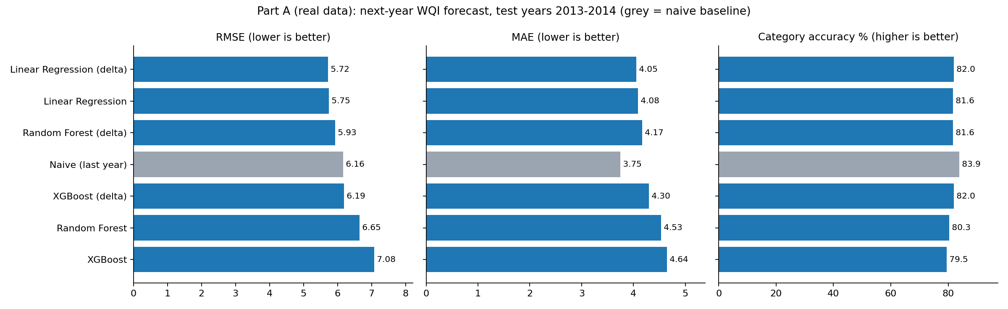
Real data: modest gain over the naive baseline
Best model: Linear (delta), RMSE 5.72 and R2 0.844, about 7% below naive (6.16). Naive keeps the best MAE (3.75) and category accuracy (83.89%).

Slide 11
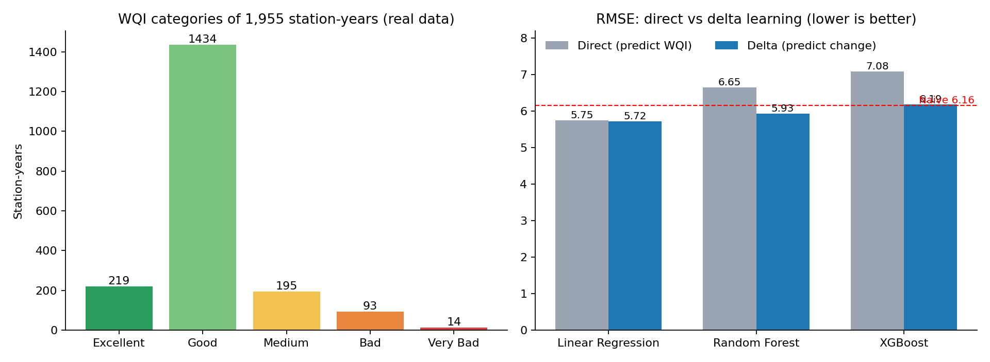
Real data: WQI categories and delta learning
Predicting the change cut RMSE from 6.65 to 5.94 for Random Forest and from 7.08 to 6.19 for XGBoost.

Slide 12
Synthetic data: the 7-day pipeline works
Model | MAE | RMSE | MAPE (%) | Category accuracy (%)
XGBoost | 3.75 | 4.85 | 4.32 | 96.83
Random Forest | 3.93 | 5.13 | 4.51 | 98.41
SARIMAX | 5.00 | 6.11 | 5.56 | 96.83
Naive | 5.52 | 6.55 | 6.15 | 96.83
XGBoost RMSE is about 26% lower than naive. The series is smooth by design, so these scores are optimistic.

Slide 13
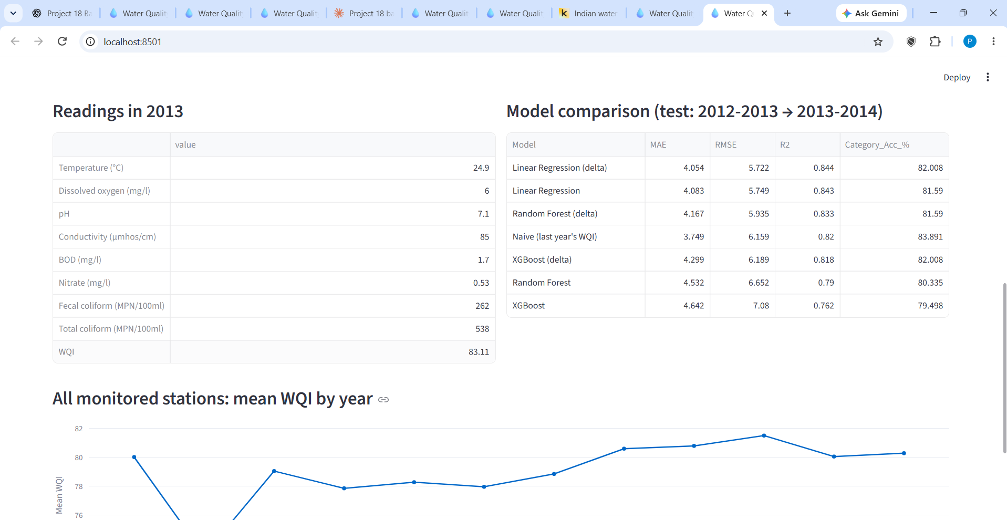
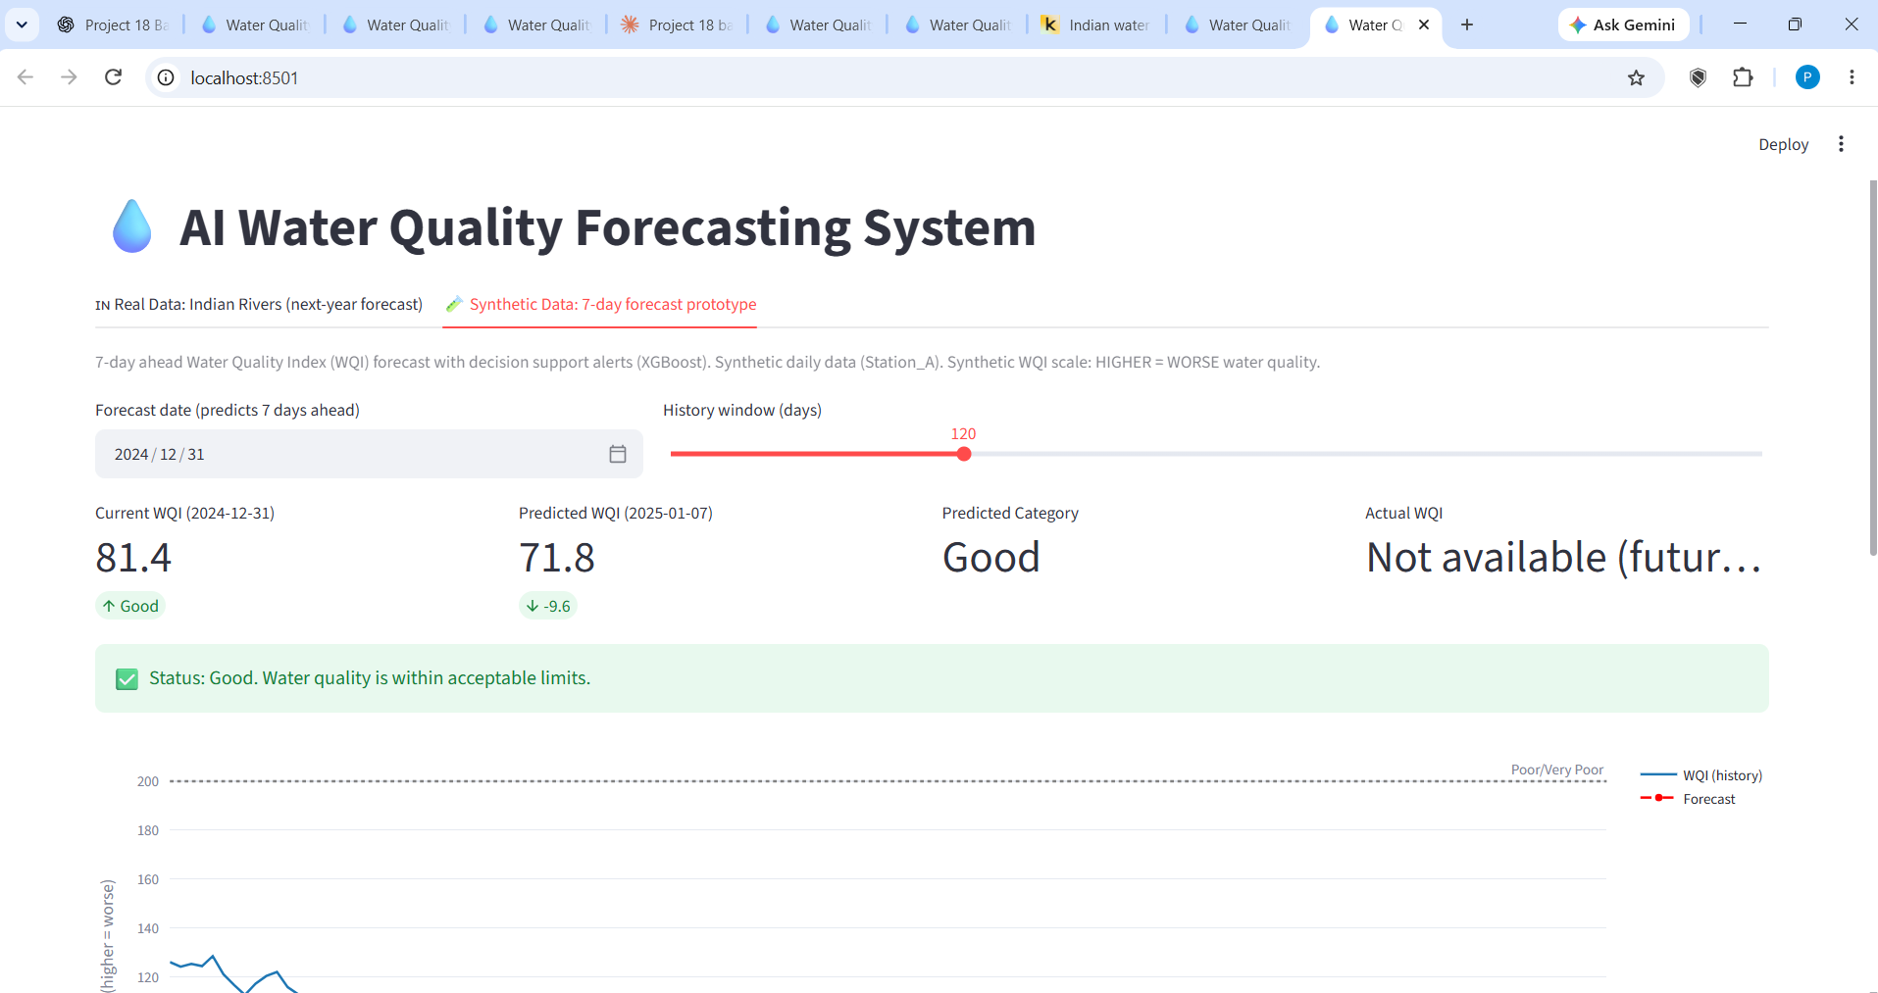
Decision-support app (Streamlit)
Real data tab
Synthetic tab
Readings, model comparison and the yearly trend for the chosen station
7-day forecast with status alert: acceptable, caution or alert

Slide 14
Conclusion and limits
What we found
Limits and next steps
Simple models predicting WQI change slightly beat the naive baseline on real yearly data. Year-to-year water quality is hard to beat with last year's value.
Yearly averages, short station histories, no significance test. Next: real daily or monthly data and live sensor feeds.
Code: https://github.com/princesahu500000-cpu/ai-water-quality-forecasting
Data: Kaggle Indian water quality data (Anbarivan.N.L). Criteria: CPCB Water Quality Criteria.

